Slide 1
Agoda website
online travel agency
Mantis Bug reports
https://www.agoda.com/

Slide 2
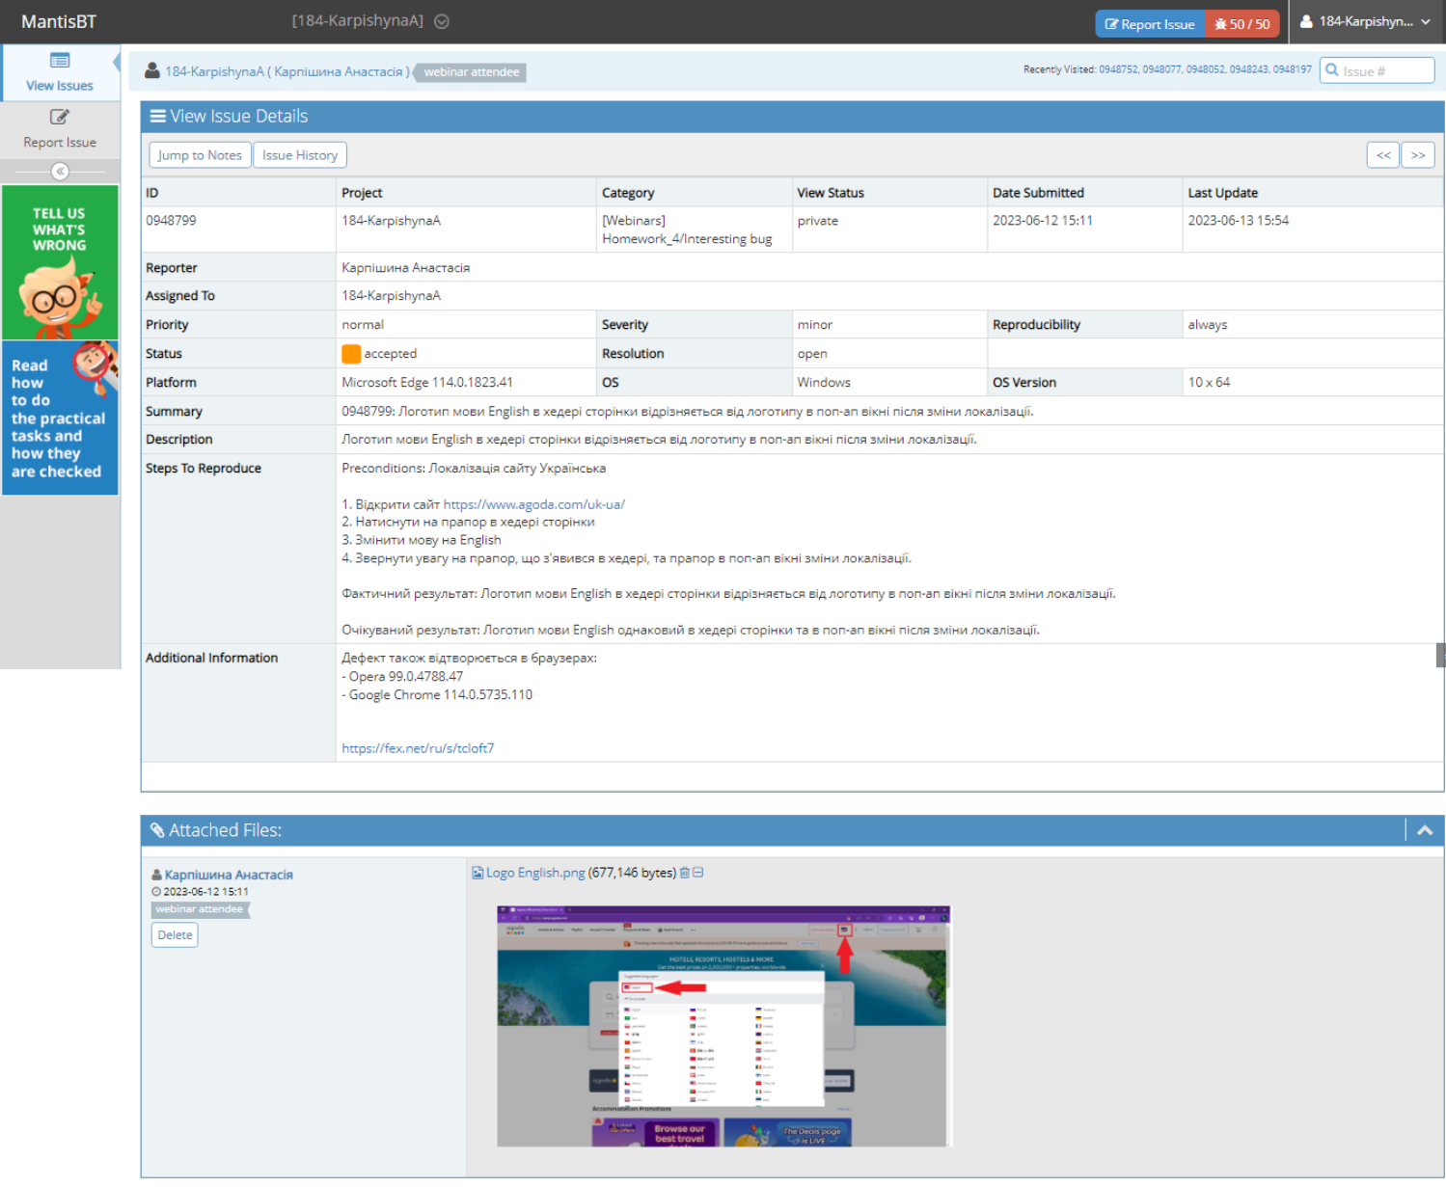

Slide 3
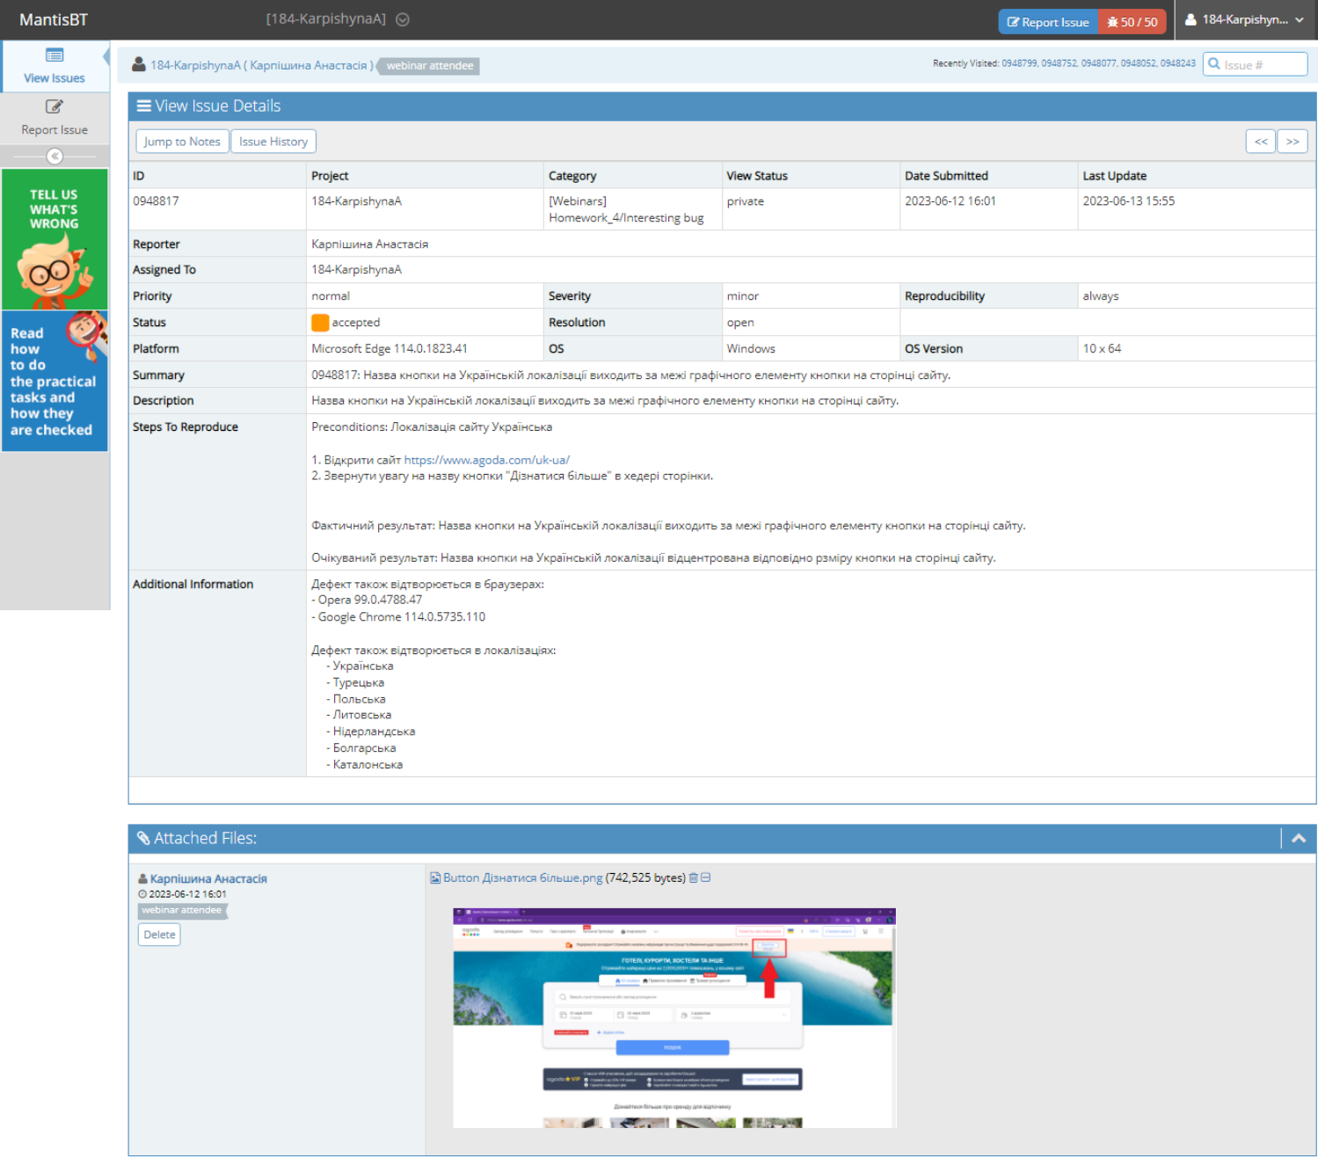

Slide 4
